Slide 1

Shadow: Scalable Simulation for Systems Security Research
CrySP Speaker Series on Privacy
University of Waterloo
January 20th, 2016
Rob Jansen
U.S. Naval Research Laboratory
rob.g.jansen@nrl.navy.mil
@robgjansen
Notes:
----- Meeting Notes (1/20/16 15:33) -----

Slide 2
Talk Outline
Shadow and how it works
Tor research case study: Kernel-Informed Socket Transport
Future directions

Slide 3
Why should you care?
Expedite research and development
Evaluate software mods or attacks without harming real users
Understand holistic effects before deployment
Shadow supports simulation for new applications

Slide 4
Experimentation Options
Thread 0

Slide 5

Desirable Properties
Controllable
Scalable
Reproducible
Accurate
Goal!

Slide 6

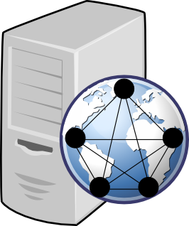
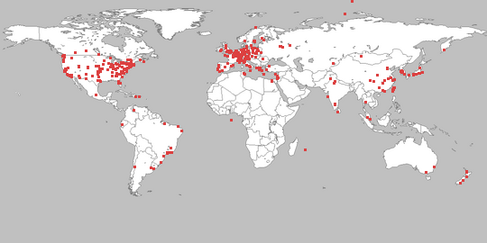
Network Research Methods
Approaches | Problems
Live Network | Hard to manage, lengthy deployment, security risks
PlanetLab | Hard to manage, bad at modeling, not scalable
Simulation | Not generalizable, inaccurate
Emulation | Larger overhead, kernel complexities

Slide 7
Simulation vs Emulation
Time (simulation wins)
Real time vs “as-fast-as-possible” execution
Emulation time must advance in synchrony with wall-clock time, or the virtual environment may become “sluggish” or unresponsive
Easier to slow down than to speed up execution!
Realism (emulation wins)
Uses host OS kernel, protocols, applications
Can run anything that runs on OS

Slide 8
Shadow
Thread 1

Slide 9
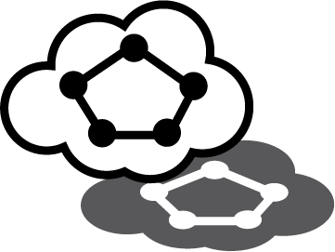
What is Shadow?
Parallel discrete-event network simulator
Models routing, latency, bandwidth
Simulates time, CPU, OS
TCP/UDP, sockets, queuing, threading
Emulates POSIX C API on Linux
Directly executes apps as plug-ins

Slide 10

Simulation Environment
Hosts
Logical processing units with independent state

Slide 11
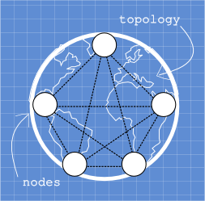
Simulation Environment
Hosts
Network
Routing elements (nodes, links) and attributes (bandwidth, latency, packet loss)

Slide 12

Simulation Environment
Hosts
Network
Global Clock
Holds current virtual time (distinct from physical time)

Slide 13

Simulation Environment
Hosts
Network
Global Clock
Event
Processing task for a host at a specific time

Slide 14
Simulation Environment
Hosts
Network
Global Clock
Event
Event Queue
Holds events sorted by time (min heap)

Slide 15
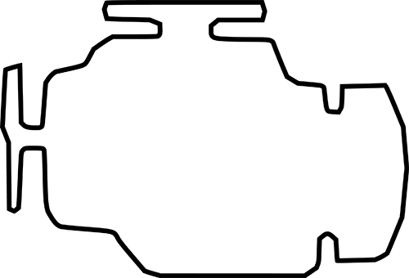
Discrete Event Engine
Facilitate communication: exchange events between hosts through the network
“as-fast-as-possible” execution

Slide 16
Discrete Event Engine
Facilitate communication: exchange events between hosts through the network
“as-fast-as-possible” execution
While !end
Get next event
Update clock
Process event
Enqueue events

Slide 17
Parallel Discrete Event Engine
Host workloads split among physical threads
Each physical thread has event queue
Synchronization problem!

Slide 18
Conservative Synchronization
Ensure causality
events must occur in correct order (not in the past)
Global time
Local times
Time barrier
Safe execution interval (min latency)
Future

Slide 19
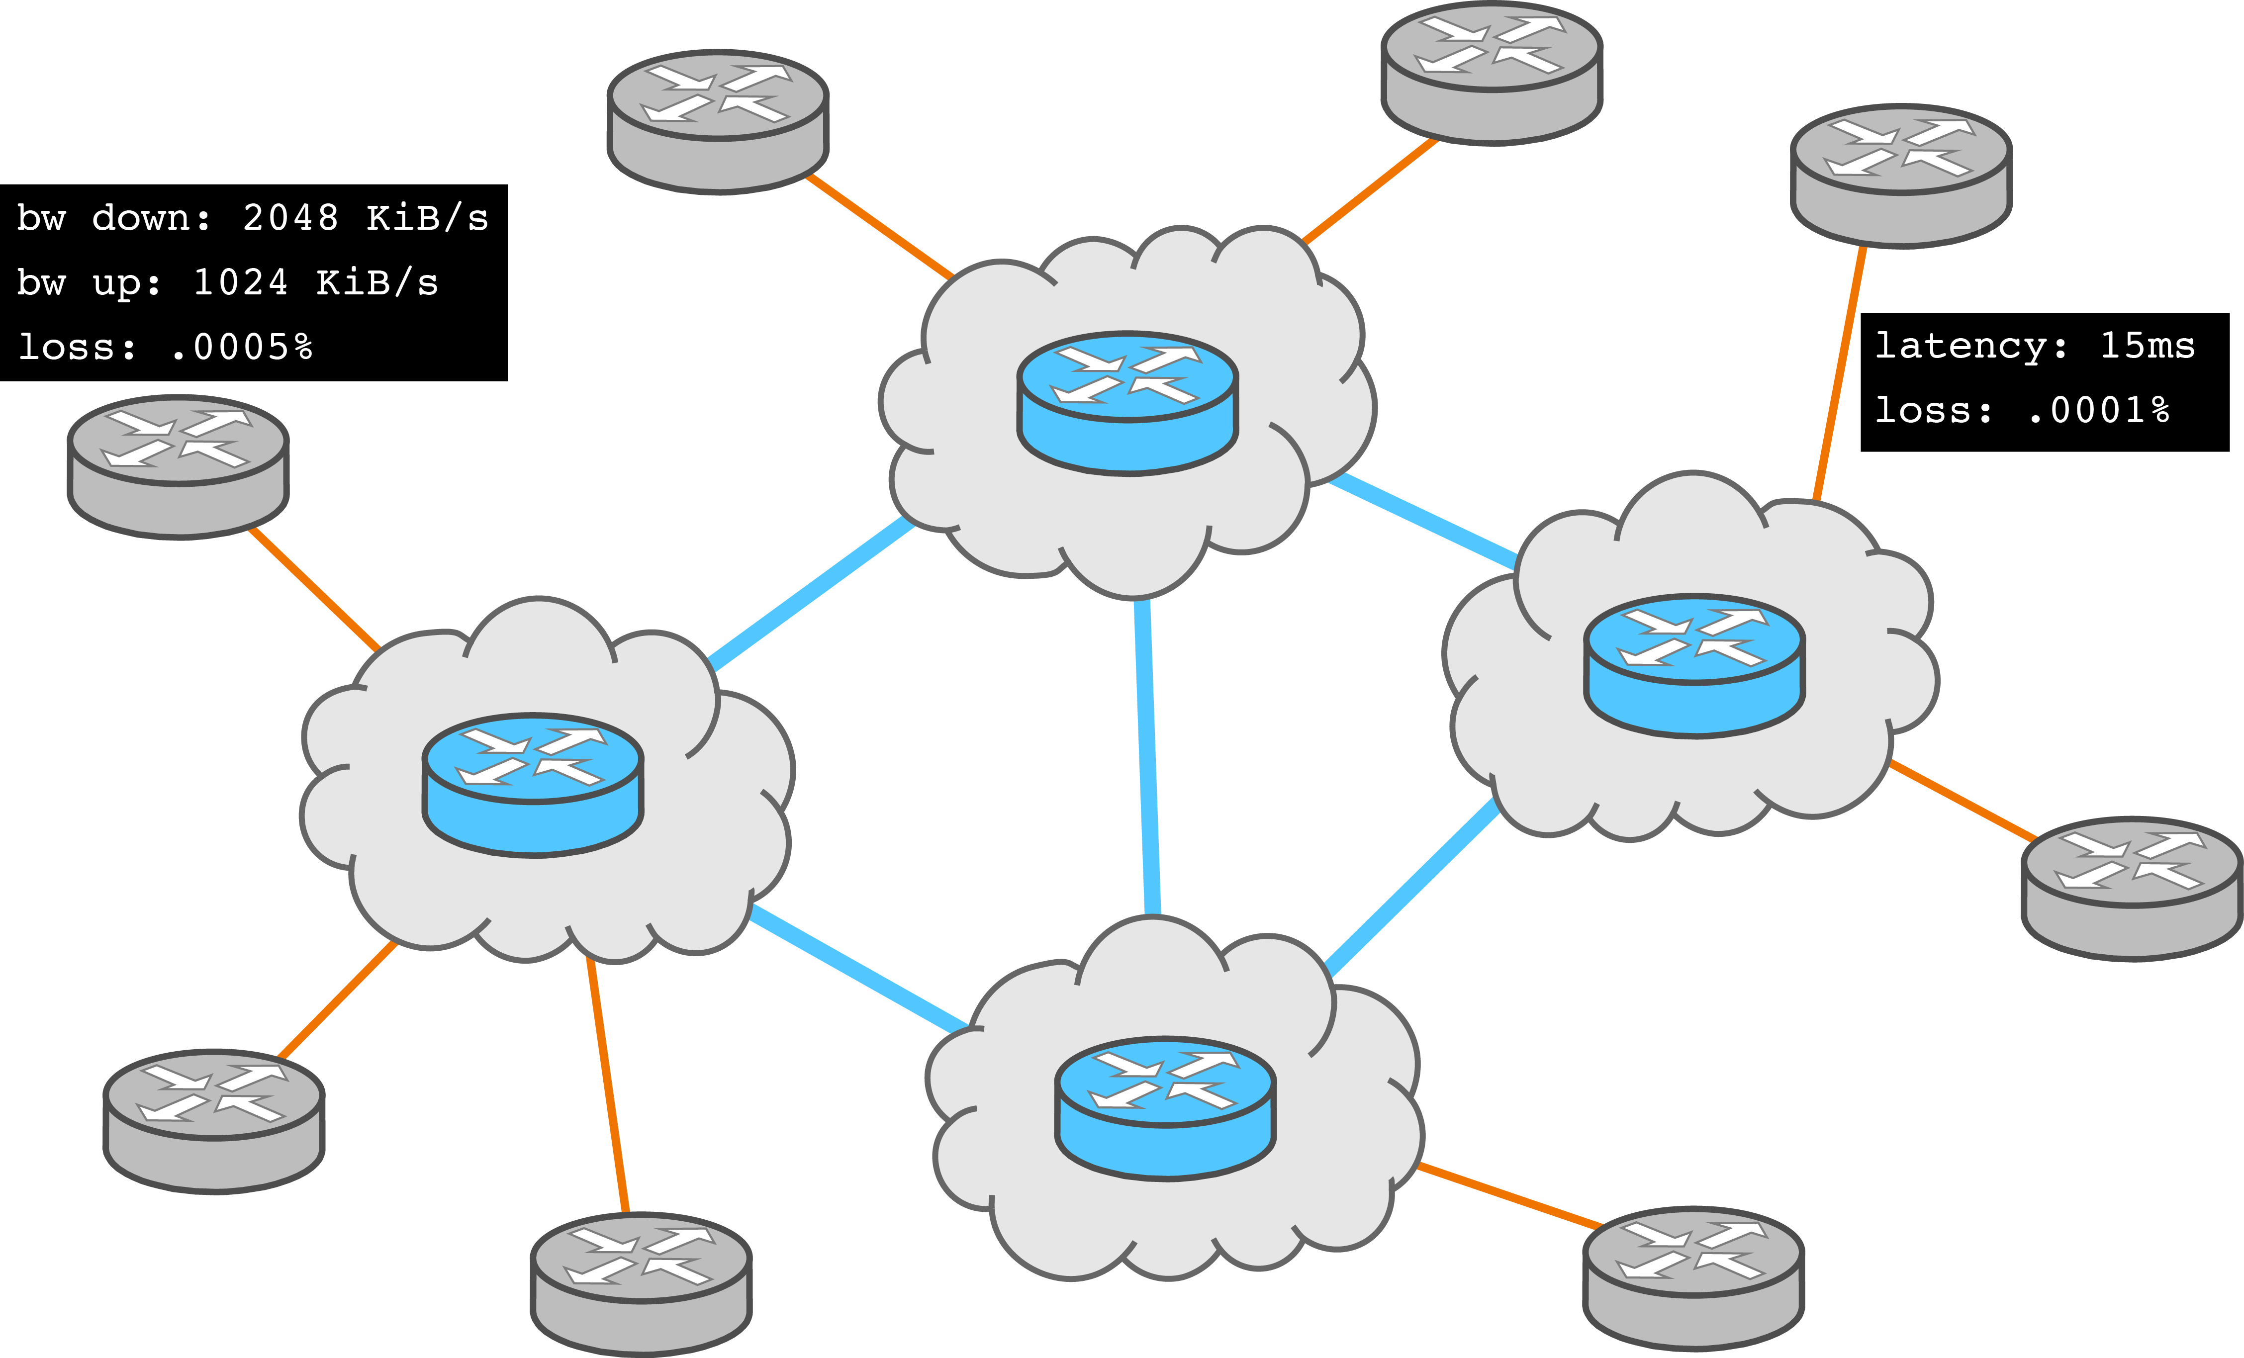
Virtual Network Routing
Network graph model
If complete:
Lookup link
Get latency
Else
Compute shortest path
Sum link latencies
Cache result
Latency and packet loss
Host connection points (IPs)

Slide 20

Executing Applications on Hosts
Load programs as dynamic shared object libraries
Compile with Clang, extract state addresses with LLVM pass
Addr | Val
0xA | 0
0xB | 0
… | …
Each program loaded only once per thread

Slide 21
Virtual Process Management
Addr | Val
0xA | 0
0xB | 0
… | …
Save default values on initial load
Copy state for each virtual process
Addr | Val
0xA | 15
0xB | 87
… | …
Addr | Val
0xA | 22
0xB | 62
… | …
Addr | Val
0xA | 33
0xB | 85
… | …
Addr | Val
0xA | 5
0xB | 59
… | …

Slide 22
Virtual Process Management
Addr | Val
0xA | 0
0xB | 0
… | …
Swap state into/out of memory as virtual processes are switched
Addr | Val
0xA | 15
0xB | 87
… | …
Addr | Val
0xA | 22
0xB | 62
… | …
Addr | Val
0xA | 33
0xB | 85
… | …
Addr | Val
0xA | 5
0xB | 59
… | …

Slide 23
Virtual Thread Management
Reentrant portable threads (rpth)
async. thread-safe, user-land non-preemptive cooperative threading
Uses make/set/get/swapcontext() magic to jump program stacks when EWOULDBLOCK
Virtual thread layer

Slide 24
Virtual Thread Management
Each virtual process has a private rpth instance
Shadow thread

Slide 25
Virtual Thread Management
Spawns an rpth thread to call the program main() function
Shadow thread
“main” thread

Slide 26
Virtual Thread Management
Program may spawn auxiliary threads
Shadow thread
“main” thread
spawned threads

Slide 27
Execution Flow with rpth
rpth scheduler (prog ctx)
Swap in virtual process and rpth state
Return to Shadow thread when all spawned rpth threads would block:
Swap out virtual process and rpth state

Slide 28
Function Interposition
App Libraries
(libc, …)
LD_PRELOAD=libpreload.so (socket, write, pthread_create, …)
rpth scheduler (prog ctx)
Function calls are redirected to simulated counterpart

Slide 29
Simulating a Kernel
Sockets and queuing
Network protocols – TCP, UDP
Threading (pthread)
Randomization (maintain determinism)
CPU usage

Slide 30
Kernel informed socket transport
Thread 2
With John Geddes, Chris Wacek, Micah Sherr, and Paul Syverson

Slide 31
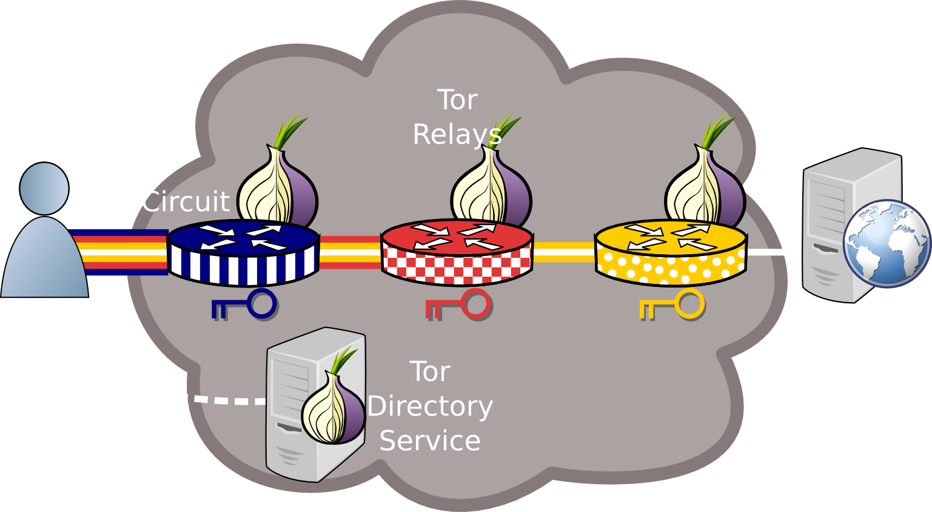
Anonymous Communication: Tor

Slide 32
This Talk
Where is Tor slow?
Measure public Tor and private Shadow-Tor networks
Identify circuit scheduling and socket flushing problems
Design KIST: Kernel-Informed Socket Transport
Use TCP snd_cwnd to limit socket writes
Evaluate KIST Performance and Security
Reduces kernel and end-to-end circuit congestion
Throughput attacks unaffected, speeds up latency attacks

Slide 33
Outline
Background
Instrument Tor, measure congestion
Analyze causes of congestion
Design and evaluate KIST
Performance
Security

Slide 34

Relay Overview

Slide 35




Relay Overview
TCP
TCP
TCP
TCP
TCP
TCP
TCP
Tor circuits are multiplexed over a TCP transport

Slide 36

Relay Overview
TCP
TCP
TCP
TCP
TCP
TCP
TCP

Slide 37
Relay Internals
Kernel Input
Tor Input
Tor Output
Kernel Output
Tor Circuits
Opportunities for traffic management

Slide 38
Outline
Background
Instrument Tor, measure congestion
Analyze causes of congestion
Design and evaluate KIST
Performance
Security

Slide 39
Live Tor Congestion - libkqtime
Kernel Input
Tor Input
Tor Output
Kernel Output
Tor Circuits

Slide 40
Live Tor Congestion - libkqtime
Kernel Input
Tor Input
Tor Output
Kernel Output
Tor Circuits
tag
match
tag
match

Slide 41
Live Tor Congestion - libkqtime
Kernel Input
Tor Input
Tor Output
Kernel Output
Tor Circuits
tag
match
tag
match
track cells

Slide 42
Shadow Network Simulation
Enhanced Shadow with several missing TCP algorithms
CUBIC congestion control
Retransmission timers
Selective acknowledgements (SACK)
Forward acknowledgements (FACK)
Fast retransmit/recovery
Designed largest known private Tor network
3600 relays and 12000 simultaneously active clients
Internet topology graph: ~700k nodes and 1.3m links

Slide 43
Shadow-Tor Congestion – UIDs
Track the UID
UID
Track the UID
UID

Slide 44
Shadow-Tor Congestion – UIDs
Track the UID
UID
Track the UID
UID
Kernel Input
Tor Input
Tor Circuits
Tor Output
Kernel Output

Slide 45
Tor and Shadow-Tor Congestion
Live-Tor
Shadow-Tor
Congestion occurs almost exclusively in outbound kernel buffers

Slide 46
Outline
Background
Instrument Tor, measure congestion
Analyze causes of congestion
Design and evaluate KIST
Performance
Security

Slide 47
Analyzing Causes of Congestion
Tor Output
Kernel Output
Tor Circuits
Queuing delays in kernel output buffer

Slide 48
Analyzing Causes of Congestion
Tor Output
Kernel Output
Tor Circuits
Problem 1:
Circuit scheduling
Problem 2:
Flushing to Sockets
Queuing delays in kernel output buffer

Slide 49
Problem 1: Circuit Scheduling
Tor Output
Kernel Output
Tor Circuits
Libevent schedules one connection at a time

Slide 50
Problem 1: Circuit Scheduling
Tor Output
Kernel Output
Tor Circuits
Tor only considers a subset of writable circuits
Libevent schedules one connection at a time

Slide 51
Problem 1: Circuit Scheduling
Tor Output
Kernel Output
Tor Circuits
Tor only considers a subset of writable circuits
Circuits from different connections are not prioritized correctly
Libevent schedules one connection at a time

Slide 52
Problem 2: Flushing to Sockets
Tor Output
Kernel Output
Tor Circuits
FIFO
Queuing delays in kernel output buffer

Slide 53
Problem 2: Flushing to Sockets
Tor Output
Kernel Output
Tor Circuits
Worse priority traffic (high throughput flows)
FIFO

Slide 54
Problem 2: Flushing to Sockets
Tor Output
Kernel Output
Tor Circuits
Worse priority traffic (high throughput flows)
FIFO
Better priority traffic
(low throughput flows)

Slide 55
Problem 2: Flushing to Sockets
Tor Output
Kernel Output
Tor Circuits
Worse priority traffic (high throughput flows)
FIFO
Must wait for kernel to flush socket to network (blocked on TCP cwnd)
Better priority traffic
(low throughput flows)

Slide 56
Problem 2: Flushing to Sockets
Tor Output
Kernel Output
Tor Circuits
Worse priority traffic (high throughput flows)
FIFO
Better priority traffic
(low throughput flows)
Reduces effectiveness of circuit priority

Slide 57
Outline
Background
Instrument Tor, measure congestion
Analyze causes of congestion
Design and evaluate KIST
Performance
Security

Slide 58
Ask the kernel, stupid!
Utilize getsockopt and ioctl syscalls
socket_space =
sndbufcap – sndbuflen
tcp_space =
(cwnd – unacked) * mss
sndbufcap
cwnd
sndbuflen
unacked

Slide 59
Kernel-Informed Socket Transport
Don’t write it if the kernel can’t send it; bound kernel writes by:
Socket: min(socket_space, tcp_space)
Global: upstream bandwidth capacity
Solution to Problem 2

Slide 60
Kernel-Informed Socket Transport
Don’t write it if the kernel can’t send it; bound kernel writes by:
Socket: min(socket_space, tcp_space)
Global: upstream bandwidth capacity
Choose globally from all writable circuits
Solution to Problem 1

Slide 61
Kernel-Informed Socket Transport
Don’t write it if the kernel can’t send it; bound kernel writes by:
Socket: min(socket_space, tcp_space)
Global: upstream bandwidth capacity
Choose globally from all writable circuits
Try to write again before kernel starvation

Slide 62
KIST Reduces Kernel Congestion

Slide 63
KIST Increases Tor Congestion

Slide 64
KIST Reduces Circuit Congestion

Slide 65
KIST Improves Network Latency

Slide 66
Outline
Background
Instrument Tor, measure congestion
Analyze causes of congestion
Design and evaluate KIST
Performance
Security

Slide 67


Traffic Correlation: Latency
Goal: narrow down potential locations of the client on a target circuit
Hopper et.al. CCS’07

Slide 68
Traffic Correlation: Latency
-Inject redirect or javascript
-Start timer
Hopper et.al. CCS’07

Slide 69
Traffic Correlation: Latency
GET
Request redirected page or embedded object
Hopper et.al. CCS’07

Slide 70
Traffic Correlation: Latency
GET
-Stop timer
-Estimate latency
Hopper et.al. CCS’07

Slide 71
Latency Attack | estimate – actual |

Slide 72
Latency Attack num pings until best estimate

Slide 73
Traffic Correlation: Throughput
Goal: find guard relay of the client on a target circuit
Mittal et.al. CCS’11

Slide 74


Traffic Correlation: Throughput
Probe throughput of all guard relays
Mittal et.al. CCS’11

Slide 75

Traffic Correlation: Throughput
Correlate throughput between exit and probes
Mittal et.al. CCS’11

Slide 76
Throughput Attack Results

Slide 77

Summary/Conclusion
Shadow
Where is Tor slow?
KIST complements other performance enhancements, e.g. circuit priority
Future work
Optimize Shadow threading algorithms
Distribute Shadow across processes/machines
shadow.github.io
github.com/shadow
robgjansen.com, @robgjansen
rob.g.jansen@nrl.navy.mil
think like an adversary

